Slide 1
Hotel Spa RESERVATION System
Presented by:
Andres, Giomar T. Bongat, Gene Carlo A. Garinga, Antonio Salvador S. Mandac, Edward Joseph R. Ngceen, Gabriel Angelo A. Orosco, Caryl Johanan C.

Slide 2
INTRODUCTION Project Context
The Asmara Spa's booking process, is manually performed. The researcher's task is to create a reservation system for the spa that will automate the process of booking a reservation and include an online reservation system for potential customers who are looking to avail the different services offered at the Asmara Spa via the internet.

Slide 3
INTRODUCTION Purpose and Description
Provide client a reservation system that will automate processes.
Prevent errors that result from manual work
The reservation system:
Shows availability of services and schedules
Utilizes a web interface for customers who want to book online

Slide 4
INTRODUCTION Objectives
General Objective: To create and implement an efficient reservation system that will automate work processes.
Specific Objectives:
To address the mistakes that occur from doing manual work processes.
Make booking more accessible through online booking
To reduce the amount of time it takes to book.
To generate a report that would show spa trends that shows how many bookings are made per day, what is the most demanded service, and what are the peak hours and days.

Slide 5
INTRODUCTION Scope and Limitations
The proposed system will be handling reservation requests from walk-in customers and online submissions.
The system automatically assigns each customers' reservation to the spa's treatment rooms and should completely eliminate reservations with overlapping time slots.
Handles the automation of assigning staff members to their reservations, but still manually inform them of the reservation they were assigned to.
The system will inform each customer of how much their reservation costs and keeps track of the status of their balance. Transactions will have to be made at the spa itself, not at the hotel whether they are checked in or not.

Slide 6
INTRODUCTION Scope and Limitations
For the payment option to be fully functional, the client may have to pay a certain fee to enable it.
An SMS feature is supposed to be added to the system to notify users when their booking time is near. Unfortunately, this feature also requires a certain fee for it to be enabled.
Monitoring of the spa assistants’ attendance is not included in the features of this system.

Slide 7
INTRODUCTION Assumptions
The pricing for the services offered by the spa is dependent on the service’s duration itself.
The spa’s attendants are well-rounded and has their fixed schedule to provide any requested services by the customers.
The spa’s receptionist and the marketing department head are the administrators of the system. Both of them will have access to the bookings.

Slide 8
REVIEW OF RELATED LITERATURE /SYSTEMS
 | Online Booking | Customer Database | Generates Reports and Analytics
Zensoft Spa & Salon Management System |  | ✓ | ✓
Agilysis |  |  | ✓
Envision Spa System | ✓ |  | ✓
Mindbody Spa System | ✓ | ✓ | ✓
Salonlite | ✓ | ✓ | ✓
Springer-Miller Systems: SpaSoft | ✓ | ✓ | ✓
Features to be Adapted from Related Systems

Slide 9
REVIEW OF RELATED LITERATURE /SYSTEMS Features of the Proposed System
Customer Database
Storing of guest profiles, identifying new and returning customers..
Online Booking
The system is constantly running 24/7 for it to be able to still accept reservations during off-hours. In case of power interruptions, the back-up plan is for the spa to revert to the manual process.
Reports
Daily reports which shows the trends on that certain day.

Slide 10
TECHNICAL BACKGROUND Programming Language
The program is built purely in the platform WordPress, a free and open-source content management system (CMS), based on PHP and MySQL.
PHP - is a server-side scripting language designed primarily for web development but also used as a general-purpose programming language.

Slide 11
TECHNICAL BACKGROUND Resource Requirements
Hardware Requirements
CPU – Intel Pentium Core 2 Duo
Disk Space – 1 GB
RAM – 1 GB
Software Requirements
Web Service – Nginx Server or Apache Server
Database Server - MySQL
Browser – Internet Explorer, Microsoft Edge, Mozilla Firefox, Google Chrome or Safari
Operating System – Windows, Linux or MAC OSX
Human Resource Requirements
Receptionist - will be the one to use the system in the front desk.

Slide 12
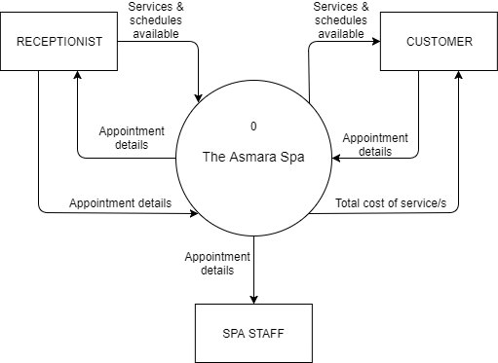
Data Flow Diagram for the Existing System
Context Diagram

Slide 13
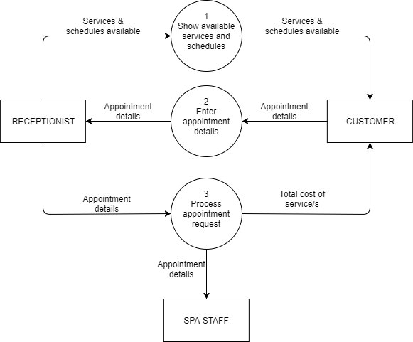
Level 0

Slide 14
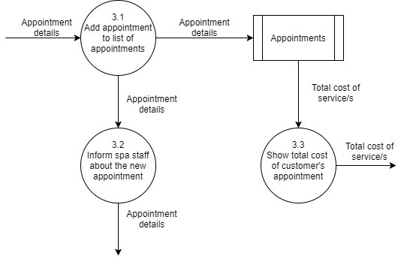
Level 1 DFD for Process #3

Slide 15
THE EXISTING SYSTEM Problem Areas
The problem of the existing system includes manual work and overlapping of appointments. Manual work may take more time to process the services that the customer wants. Booking appointments of the existing system may overlap and cause errors.

Slide 16
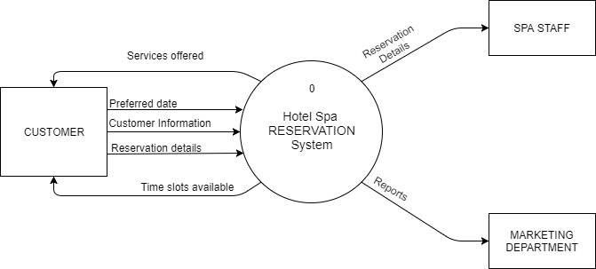
Data Flow Diagram for the Proposed System
Context Diagram

Slide 17
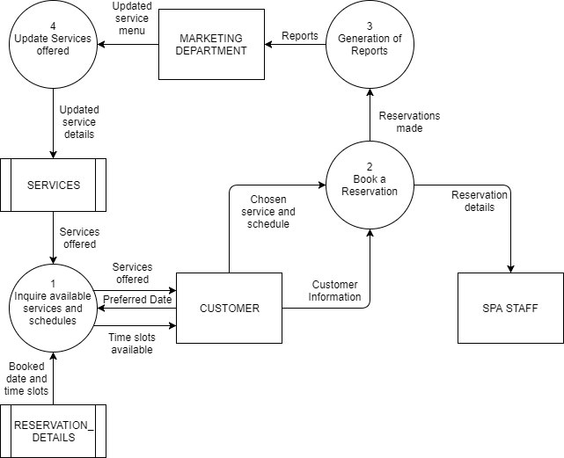
Level 0 DFD

Slide 18
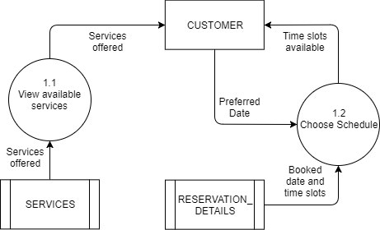
Level 1 DFD for Process 1

Slide 19
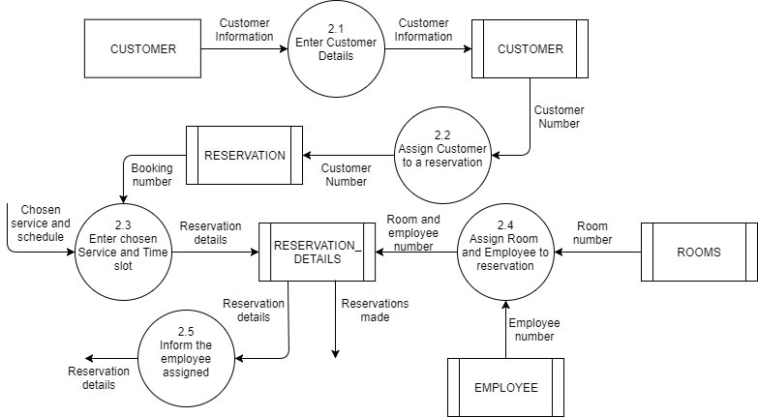
Level 1 DFD for Process 2

Slide 20
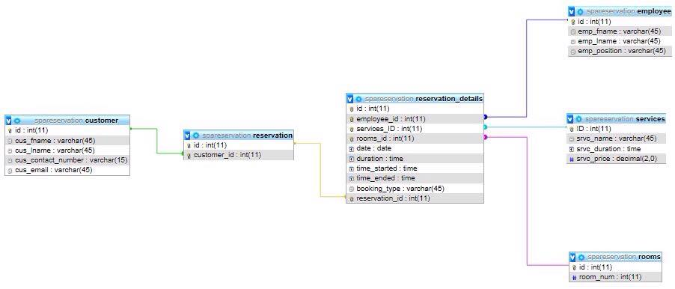
Entity Relationship Diagram

Slide 21
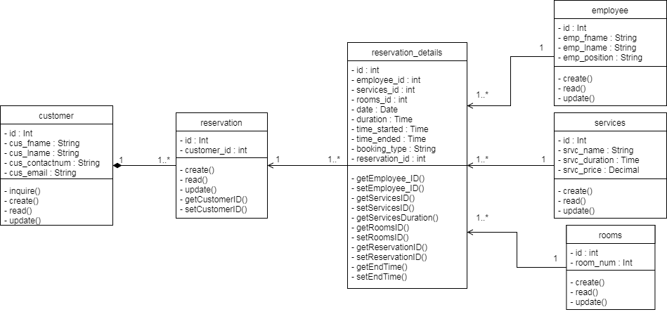
Class Diagram

Slide 22
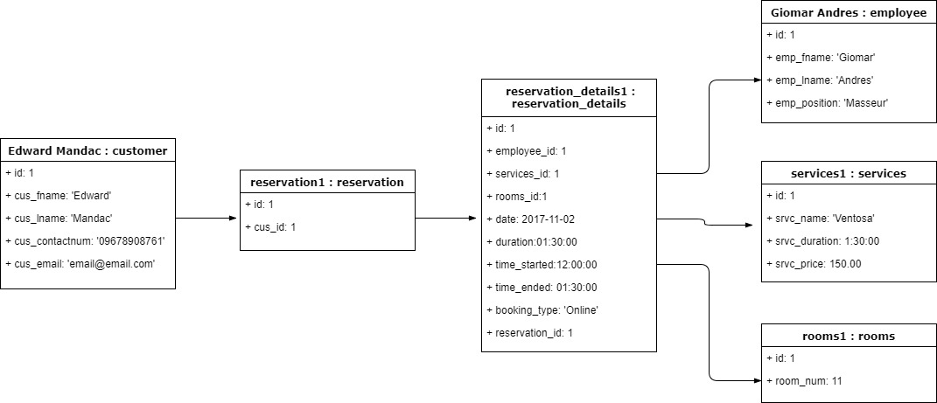
Object Diagram

Slide 23
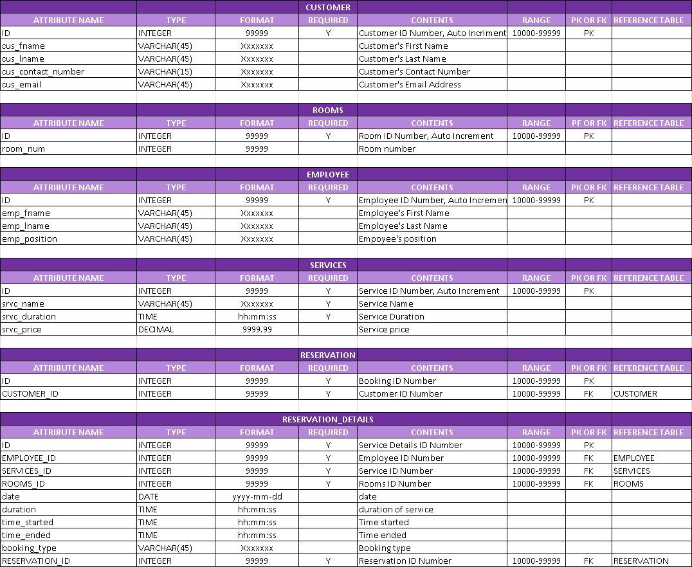
Data Dictionary

Slide 24
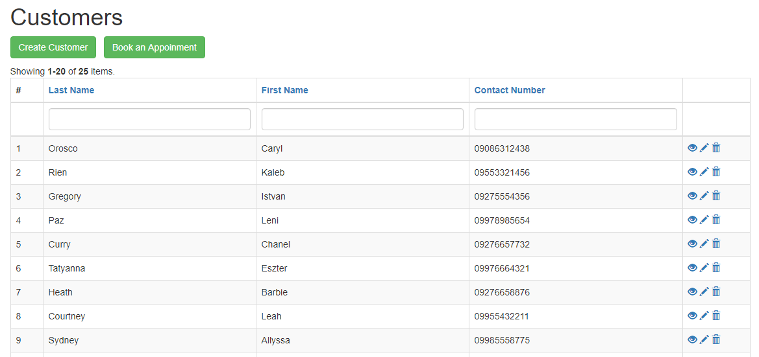
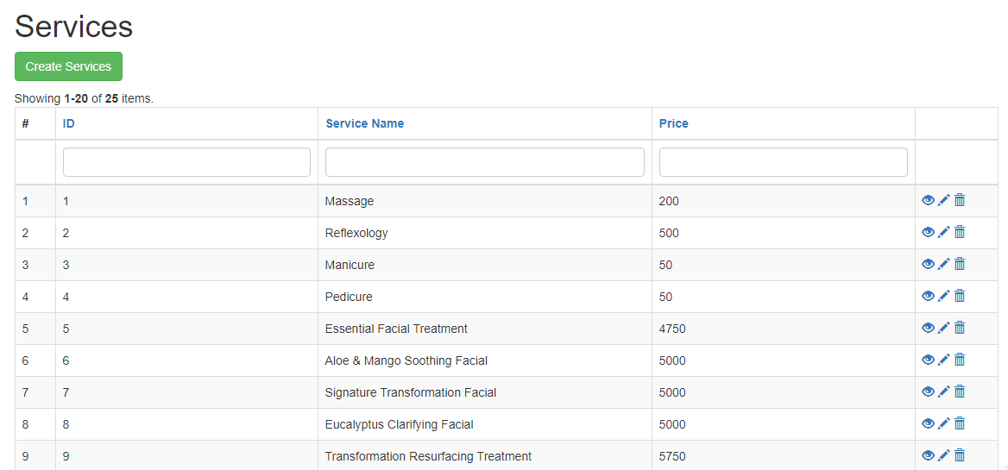
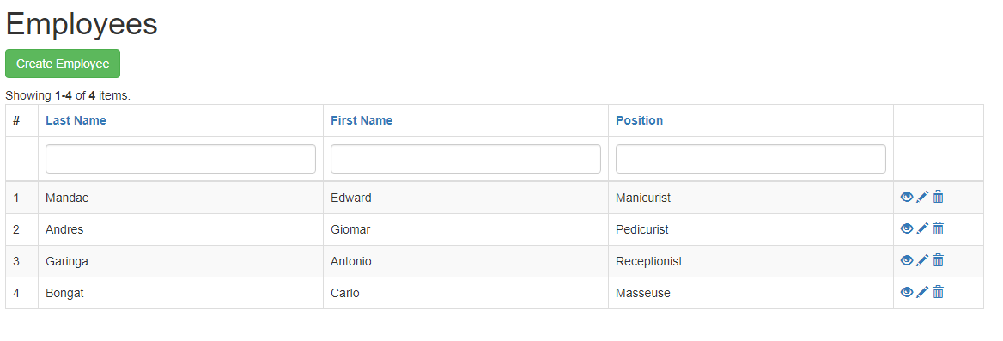
Tables/Files Layout

Slide 25
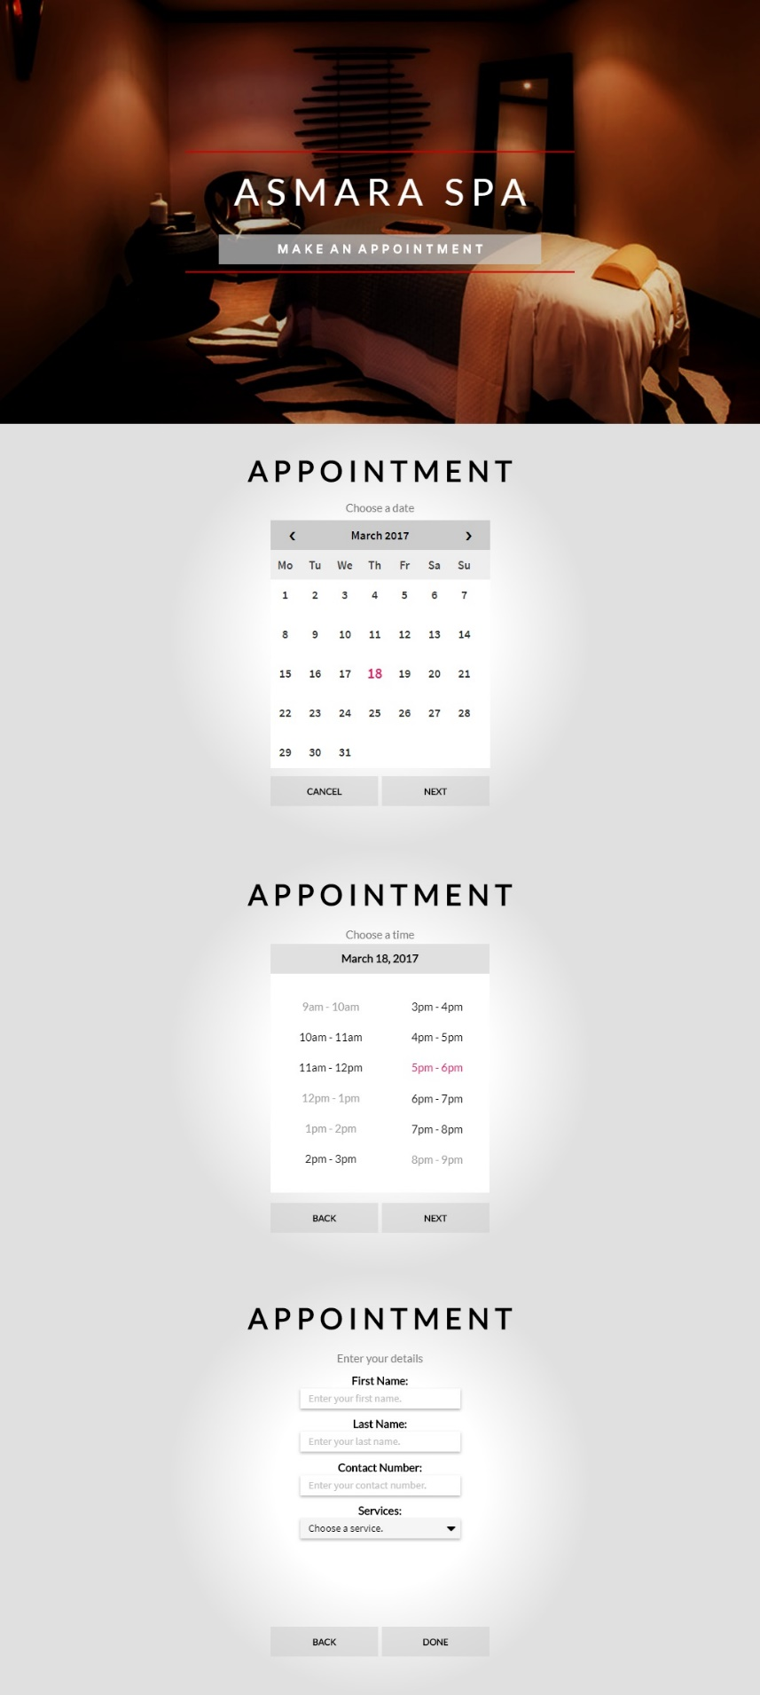
Screen Layout/Specification

Slide 26
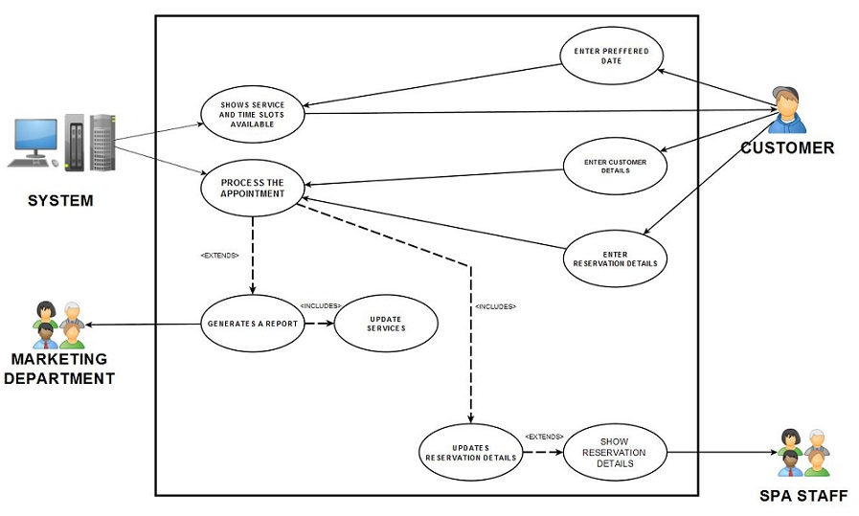
Use Case Diagram

Slide 27
USE CASE | Reservation
ACTOR | Customer
DESCRIPTION | Process of customer reservation
SUCCESSFUL COMPLETION | Customer enters their preferred date. Customer enters their details Customer enters their reservation details Once the reservation details are processed, the customer will wait until their reservation schedule comes.
ALTERNATIVE | 1a. Customer is a walk-in guest and wants the service at the exact moment.
PRE-CONDITION | Spa must be online
ASSUMPTIONS | Reservation details were successfully sent.
Fully Dressed Use Case

Slide 28
USE CASE | Spa Service
ACTOR | Spa Staff
DESCRIPTION | How the staff are assigned
SUCCESSFUL COMPLETION | The spa staff is assigned to a reservation The spa staff waits for the schedule of reservation
ALTERNATIVE | 1a. Spa staff handles the walk-in customer
PRE-CONDITION | Each spa staff is able to perform any type of service that the spa offers.
ASSUMPTIONS | Reservation details are successfully received.
Fully Dressed Use Case

Slide 29
USE CASE | Report Collection
ACTOR | Marketing Department
DESCRIPTION | How reports are acquired
SUCCESSFUL COMPLETION | Marketing head will wait for the daily report Changes in services will be made by the Marketing head if needed
ALTERNATIVE
PRE-CONDITION | Marketing department has received the report
ASSUMPTIONS | The Marketing head updates the services by the report
Fully Dressed Use Case

Slide 30
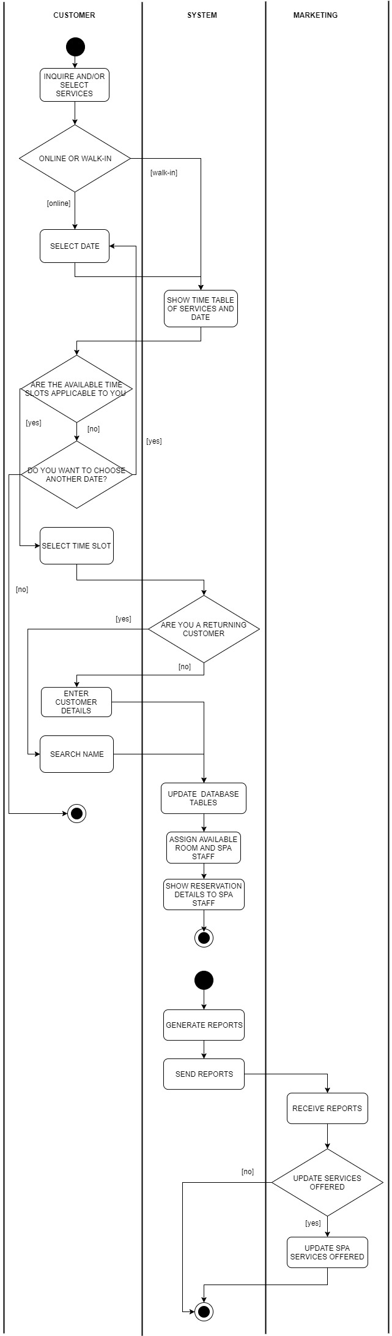
Activity Diagram

Slide 31
Activity Diagram

Slide 32
Activity Diagram

Slide 33
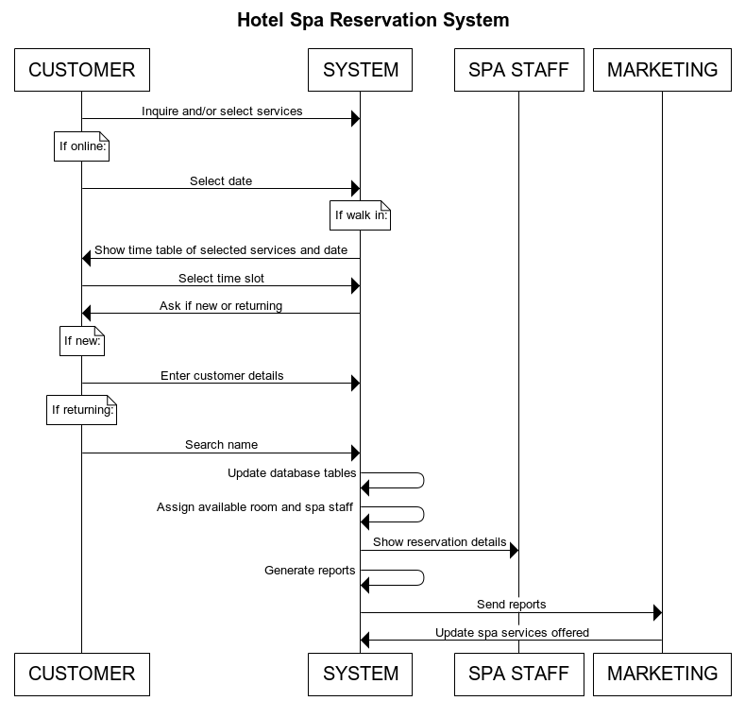
Sequence Diagram

Slide 34
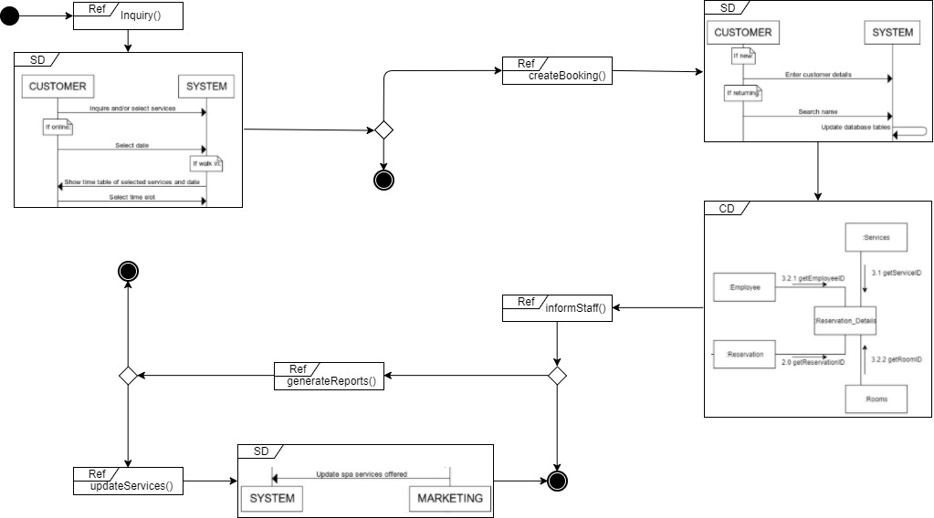
Interaction Overview Diagram

Slide 35
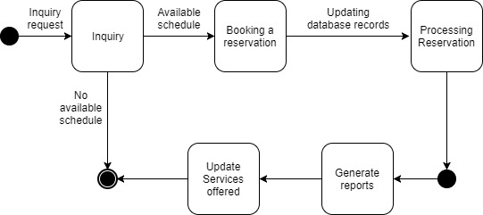
State Machine Diagram

Slide 36
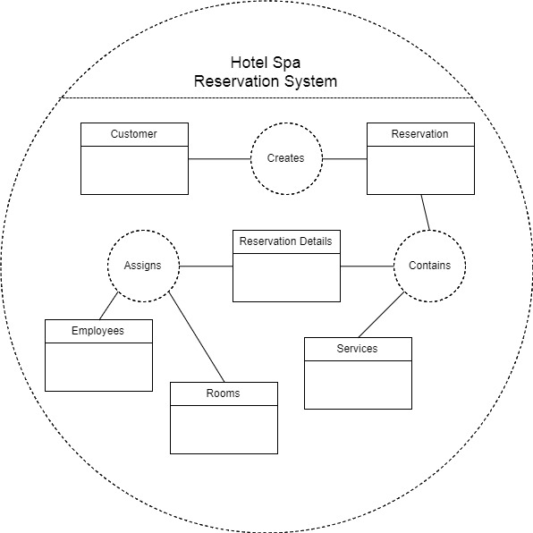
Composite Structure Diagram

Slide 37
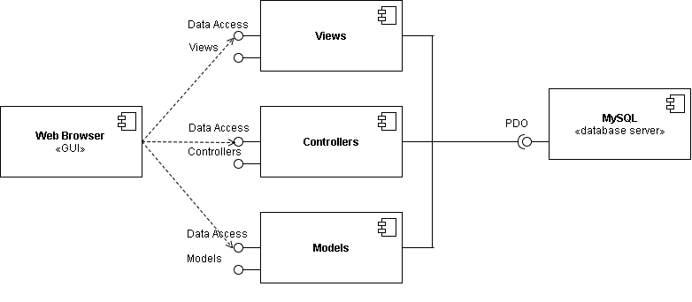
Component Diagram

Slide 38
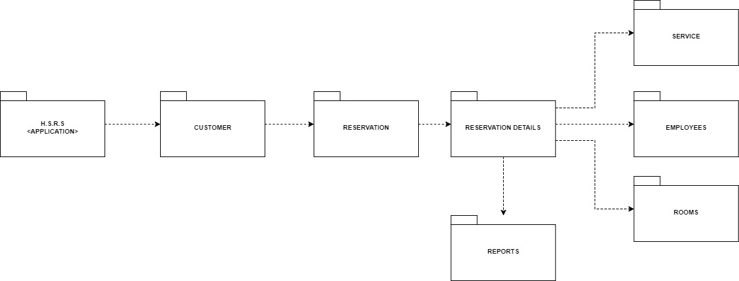
Package Diagram

Slide 39
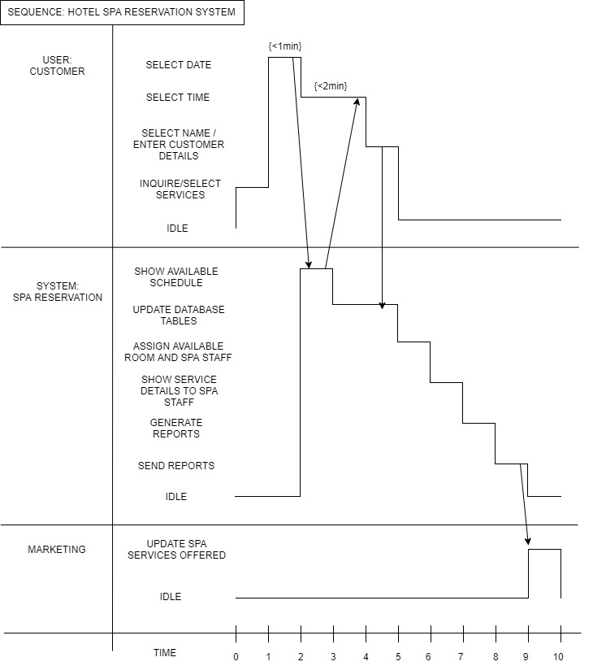
Timing Diagram

Slide 40
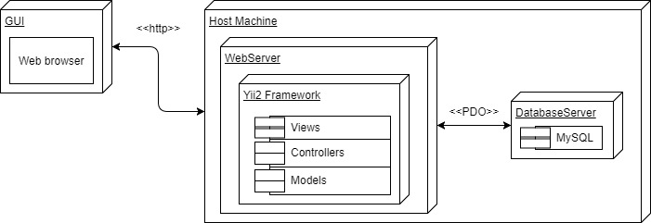
Deployment Diagram

Slide 41
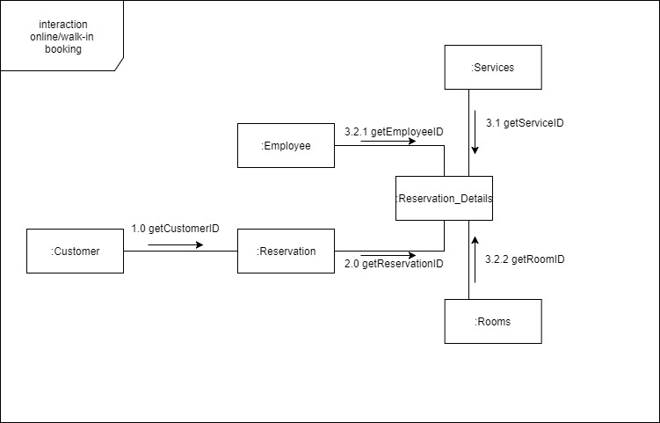
Communication Diagram

Slide 42
User Requirements | Current Process | Proposed Changes
The system addresses/prevents the mistakes that occur from doing manual work processes. | All processes in the Asmara Spa is manual. In line with this, a lot of errors could occur. (e.g. lost appointments, wrong dates written on appointments) | The system will automate the process of booking a reservation and include an online reservation system for potential customers who are looking to book a reservation to the Asmara Spa via the internet.
To make the booking process more accessible | The booking process is a bit inconvenient because one way to make an appointment is through a third party website and none on their hotel website. | A web based system for customers who’d want to book a reservation but isn’t a guest checked-in at the hotel that will serve as an alternative.
To reduce the amount of time and resources needed in the booking process | In a manual work process, with errors occurring , a lot of time could be wasted fixing mistakes and it would require several people to do a certain task | The system aims to automate work processes so that less time and people are needed to complete a task.
To convert the spa’s work environment into a paperless office | Since every booking is manually done, it is assumed that they are currently logged into a log book or slips are compiled into a folder. | With the use of the system, the use of paper will gradually lessen.
To generate a report that would show spa trends | To see what trends, the spa has to review their list of reservations/bookings and manually tally the data enlisted in it. | The system will generate a report based from the data collected in the system’s database server, which will show how many reservations they had for the day, what is the most popular service, and what are the peak hours and days.
GAP ANALYSIS

